Slide 1
Accelerated Reader
Thursday 22nd October 2020
Miss Frain

Slide 2
What is Accelerated Reader?
Accelerated Reader is a programme we use from Year 3 upwards at Civitas Academy.
It can be accessed at school and at home via the school website.
It is an online system that encourages children to develop their comprehension skills and vocabulary.
Children have a range of numbered books they can read- these replace the coloured book bands that they were reading in KS1.
Once children have read their book, the AR programme will assess their understanding of it through an online quiz.

Slide 3
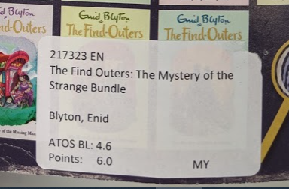
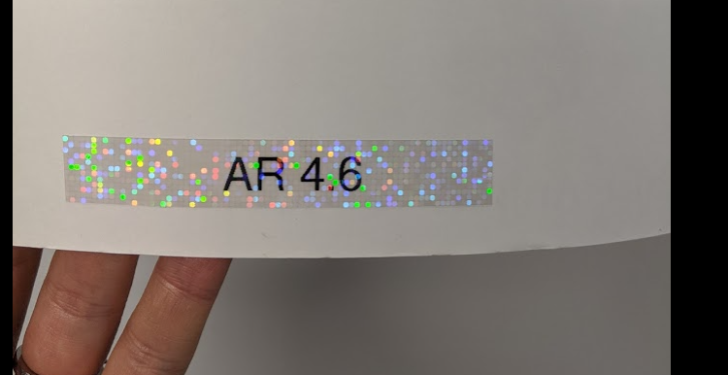
How does my child know their level?
. Your child’s teacher will tell your child the level of books they should be reading. It will be a RANGE e.g. 2.5-2.9.
These numbers within the books reflect the vocabulary used and the level of the comprehension quiz.
You will know if a book is on Accelerated Reader because it will have a sticker inside.

Slide 4
Inside the books is a sticker. This tells the children the level that it is and the points it is worth on a quiz.
This book is level 4.6 and is worth 6.0 points.
The children know their levels, so if a child is reading between 4.5-5.0 they could choose this book.
Once they complete the quiz, they would gain 6 points.

Slide 5
How do I access Accelerated Reader?
Your child will be provided with a username (usually the initial of their first name and the first 3/4 letters of their surname) and a password.
You MUST access it through the school website.

Slide 6
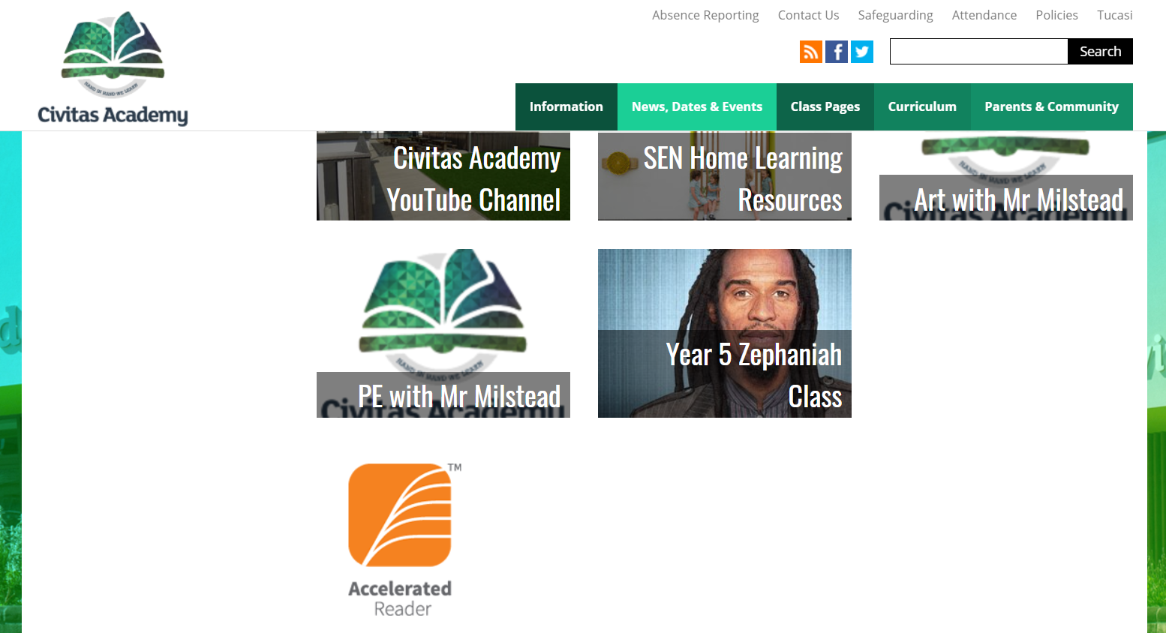

Slide 7
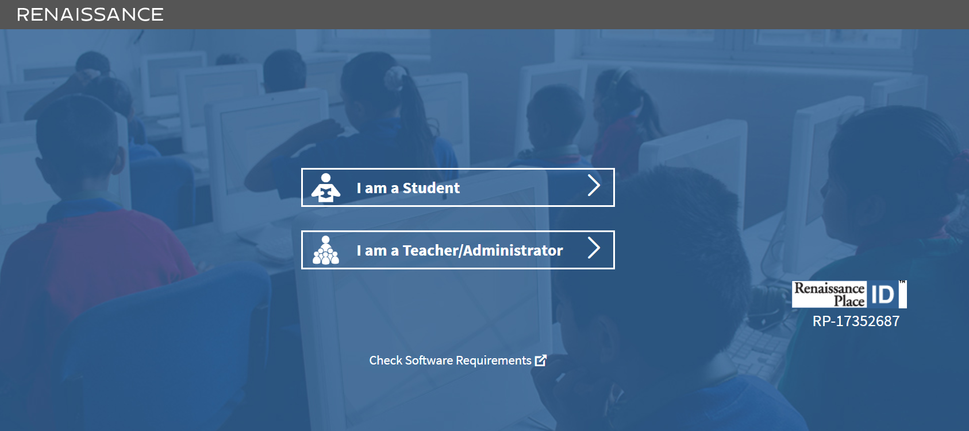

Slide 8
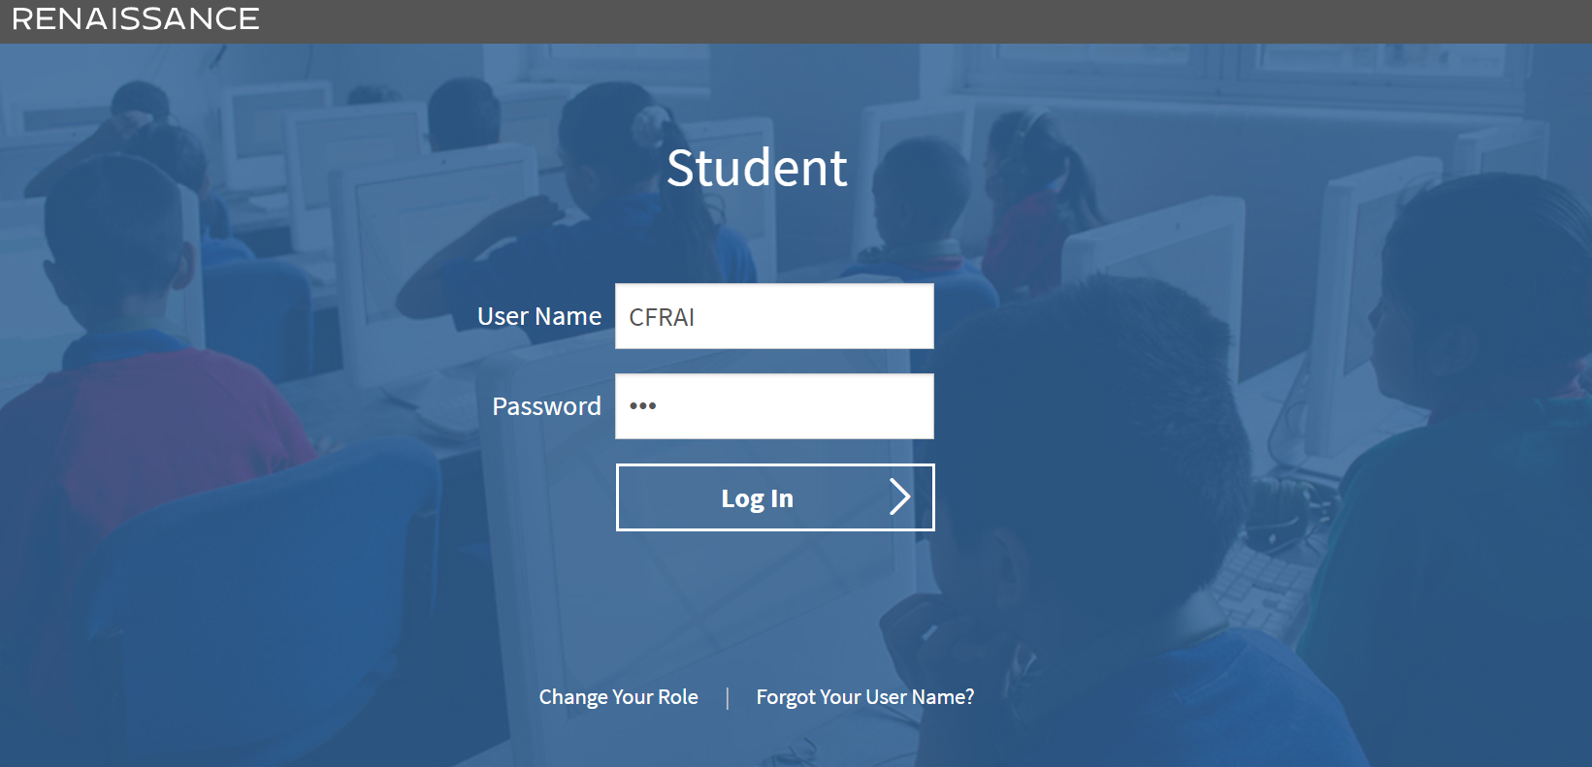

Slide 9
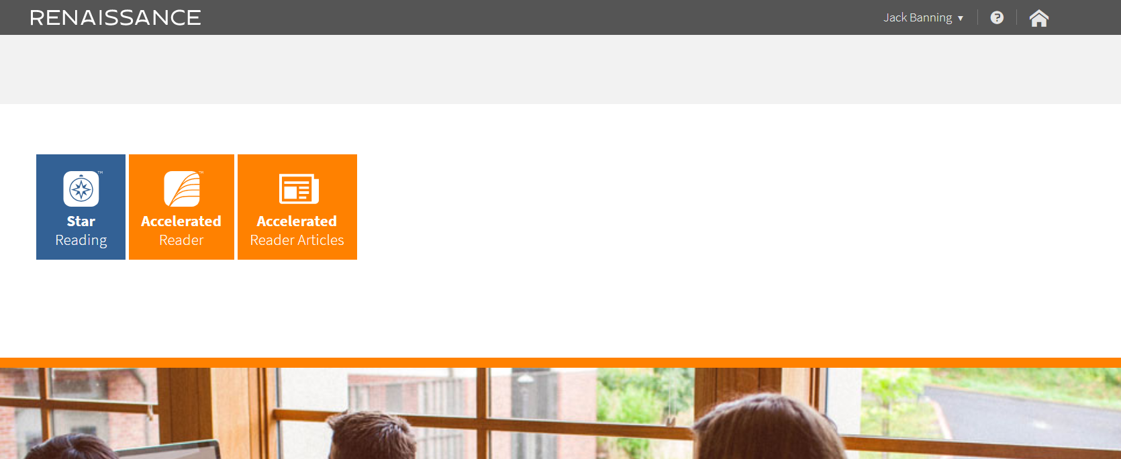
Used further up the school. Does NOT apply to Year 3s.
System used in school by teachers on a half termly basis.
System used to check comprehension in school and can also be used at home ☺

Slide 10
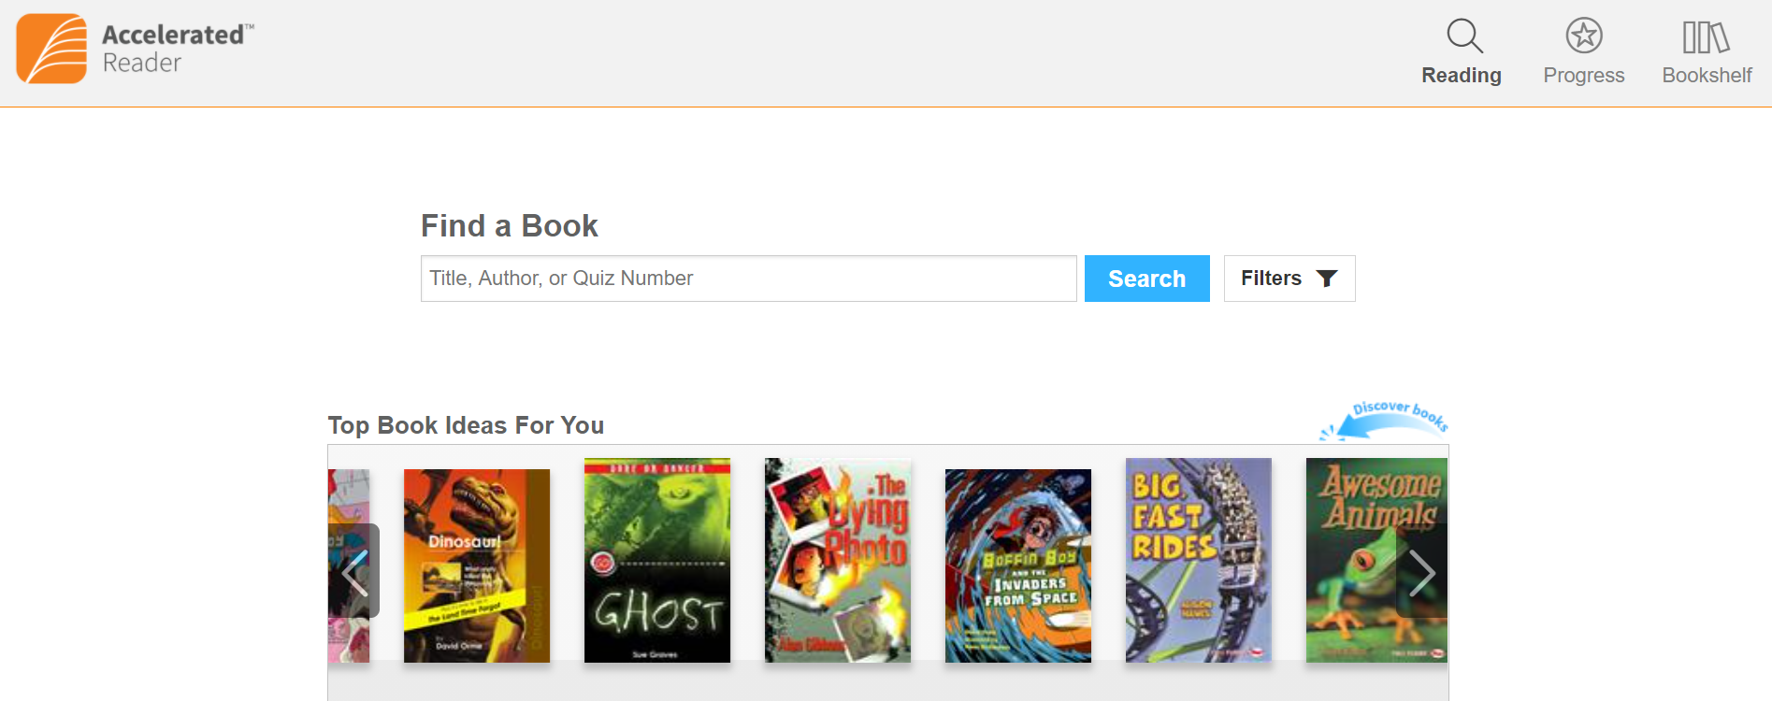
Children can type in the title or number inside the book to find it.

Slide 11
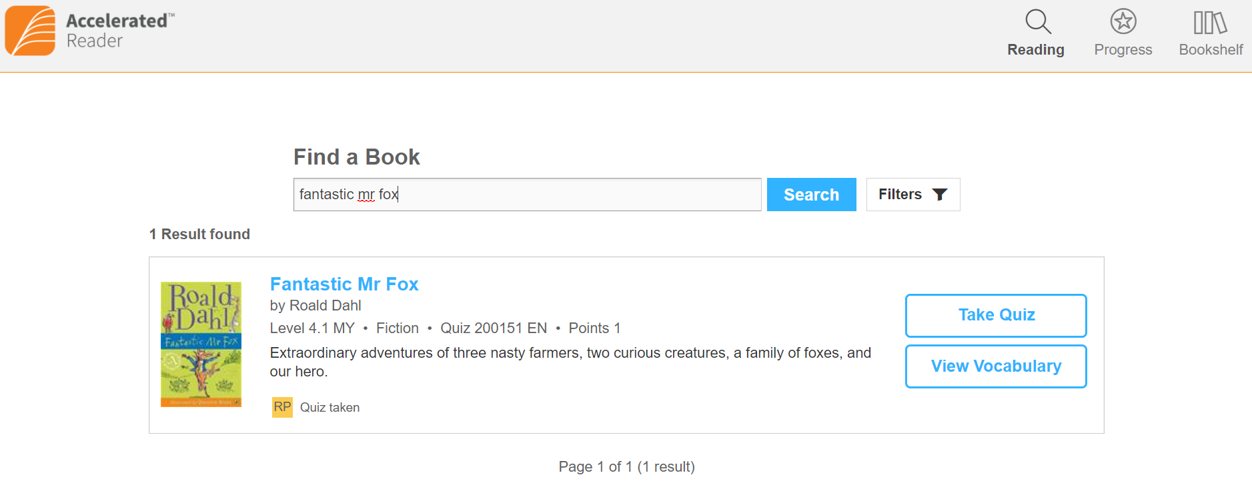
Here is an example of one of the books I searched for.
Children can only take a quiz once.

Slide 12
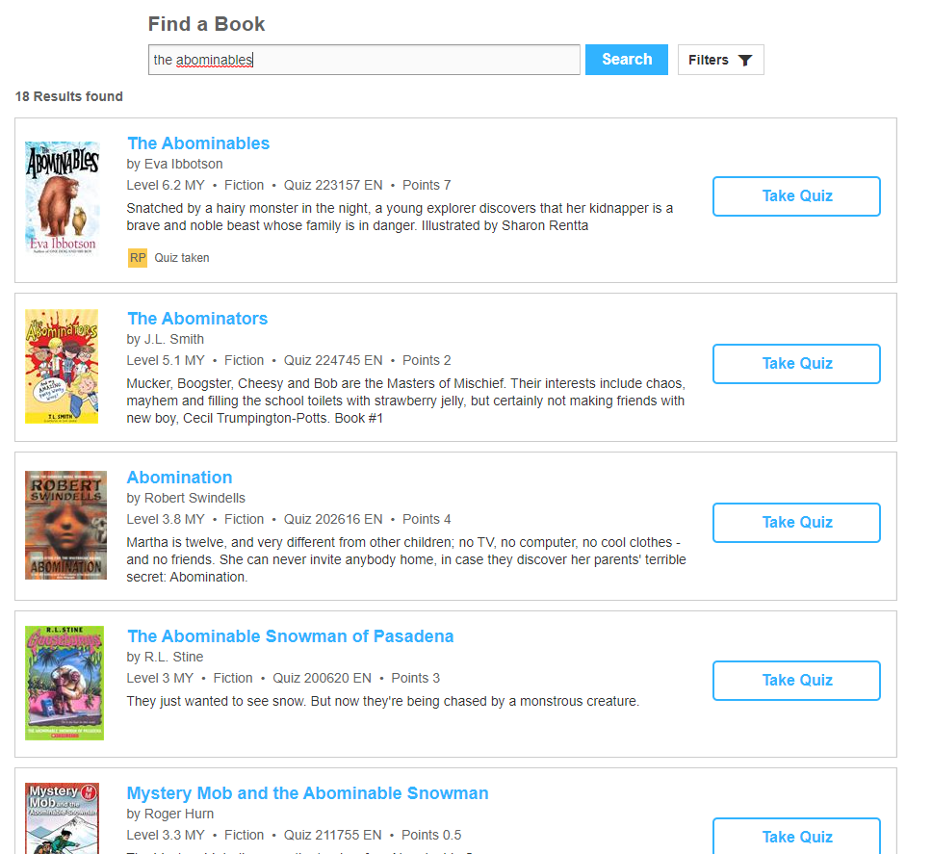
Sometimes a wider range of books will come up and your child may need to scroll down.
The front covers may not look the same- they need to check the title and author.

Slide 13
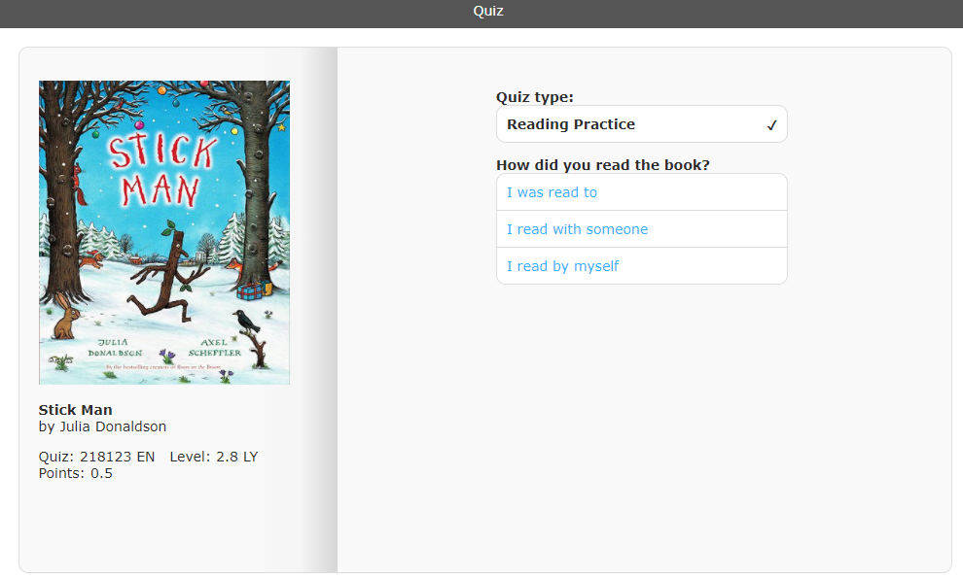

Slide 14
Children cannot stop the quiz – it is important they have the text with them if they can to refer to.
It is multiple choice so children select the answer and move to the next question.

Slide 15
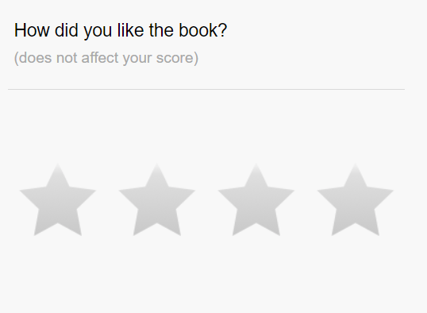
At the end of the quiz, children rate the book they have read.

Slide 16
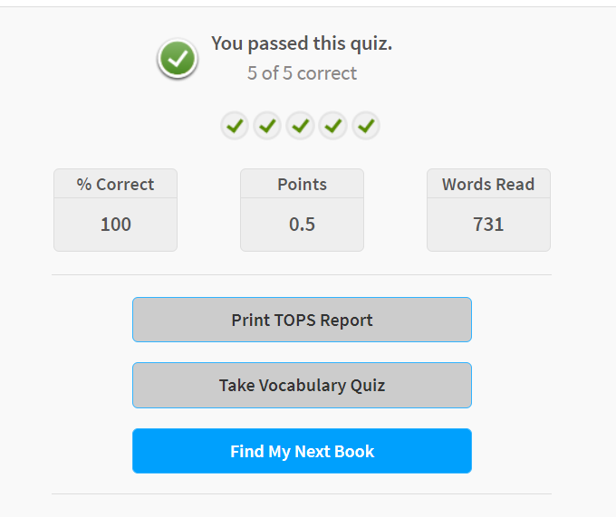
Children need 80% to pass a quiz.
4/5
8/10
Children can see how many words they read within that book.
Some books have an additional vocabulary quiz that can also be completed (same format)

Slide 17
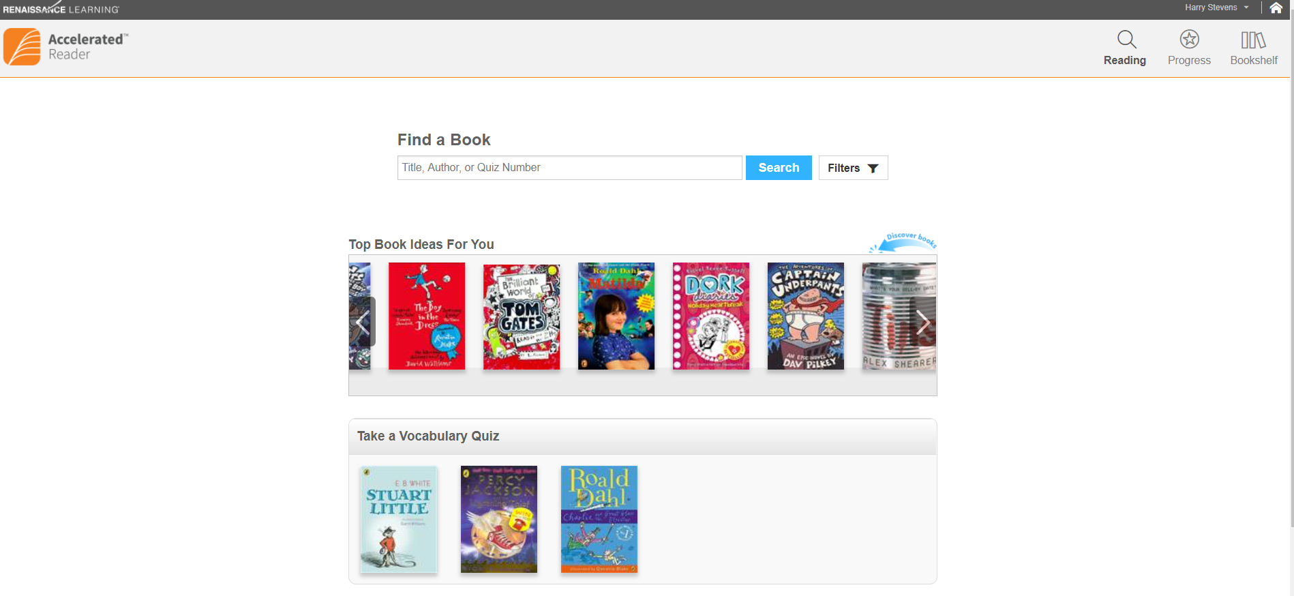

Slide 18
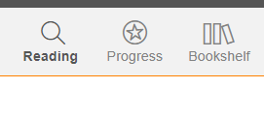
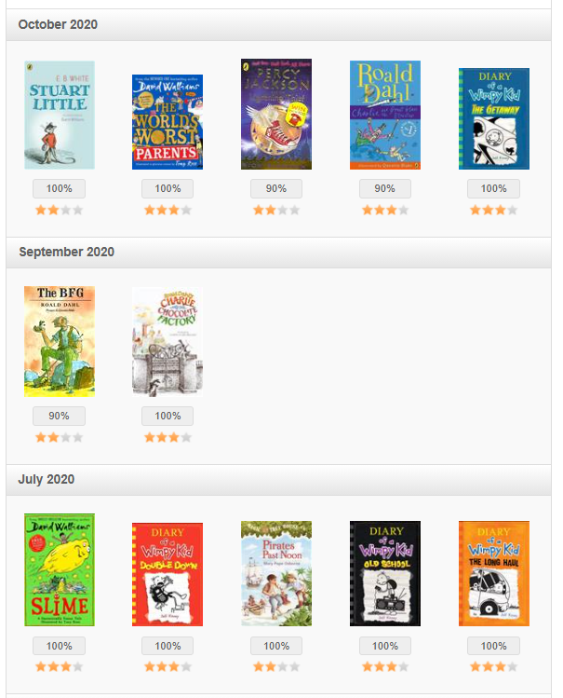
Allows you to see what books your child has read.

Slide 19
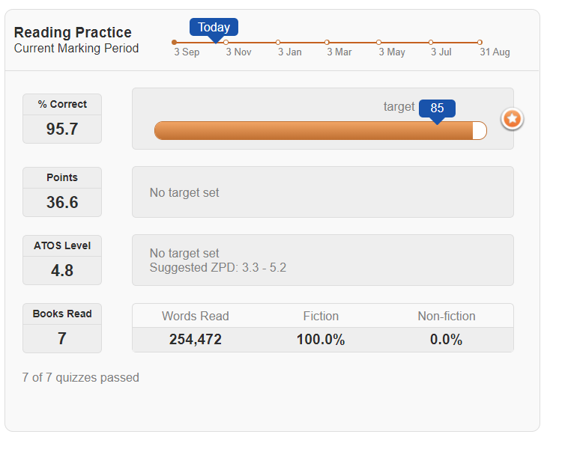
Allows you to see how your child is doing.

Slide 20
How often will my child change their book?
Your child can change their book during allotted times every day- usually they will have an opportunity every day to do this.
Year 3 classes will have access to the laptops on Mondays and Tuesdays and can do Accelerated Reader quizzes then.
Teachers regularly monitor quizzes and prompt children to change their books, however the children are also responsible for choosing books within their level and doing this regularly. Teachers will support children when needed.

Slide 21
My child can’t access Accelerated Reader.
1. CHECK you have accessed it THROUGH THE SCHOOL WEBSITE.
2. CHECK that they are typing in their correct username.
3. CHECK that they are typing in their password correctly – this is case-sensitive and should all be in the lower-case.
4. Contact year3@civitasacademy.co.uk by email.

Slide 22
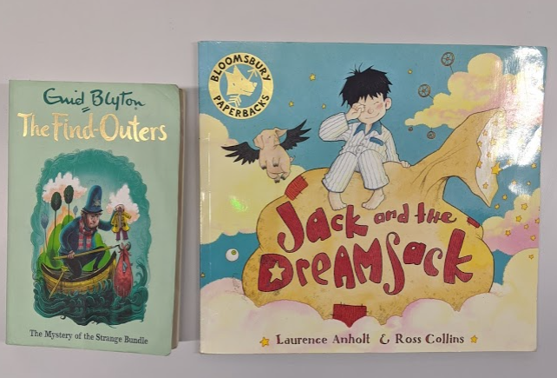
I think the range my child has is too easy/hard.
Within that range, there will be a lot of different books for your child to choose.
Both of these books are level 4.6 so they have a similar vocabulary level.
One is a picture book and is worth 0.5 points on a quiz.
The other is a chapter book and worth 6.0 points on a quiz.
Teachers monitor comprehension scores very regularly and will adjust the range accordingly.

Slide 23
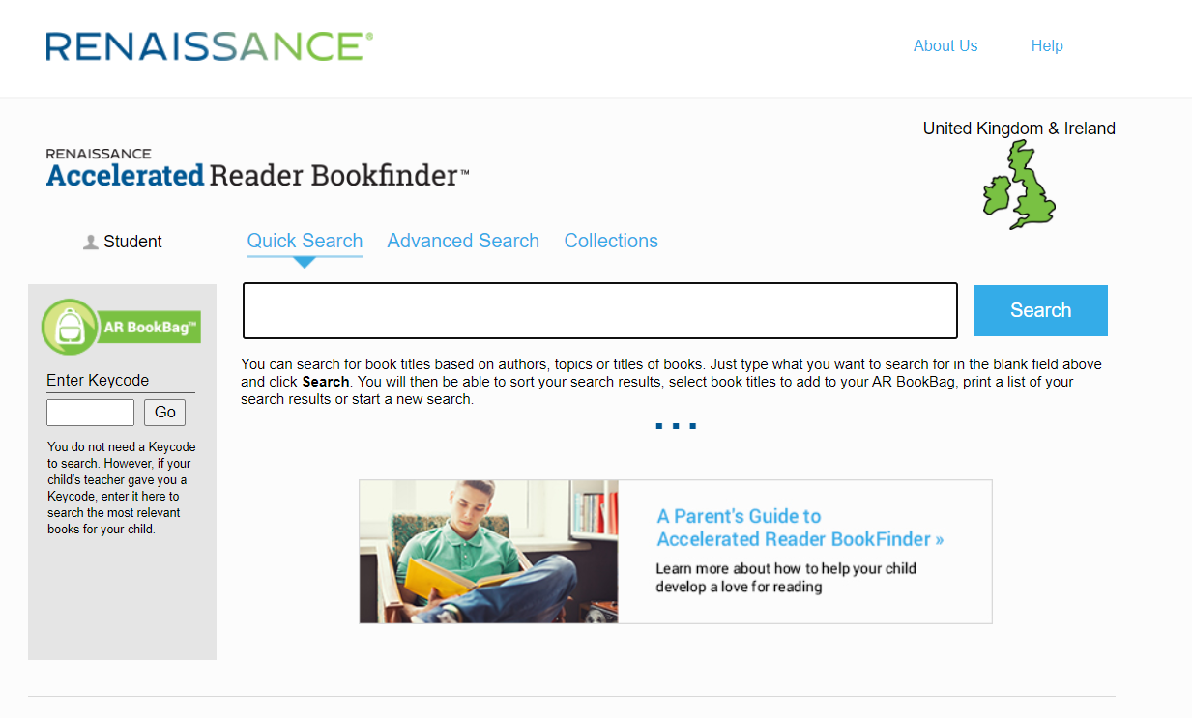
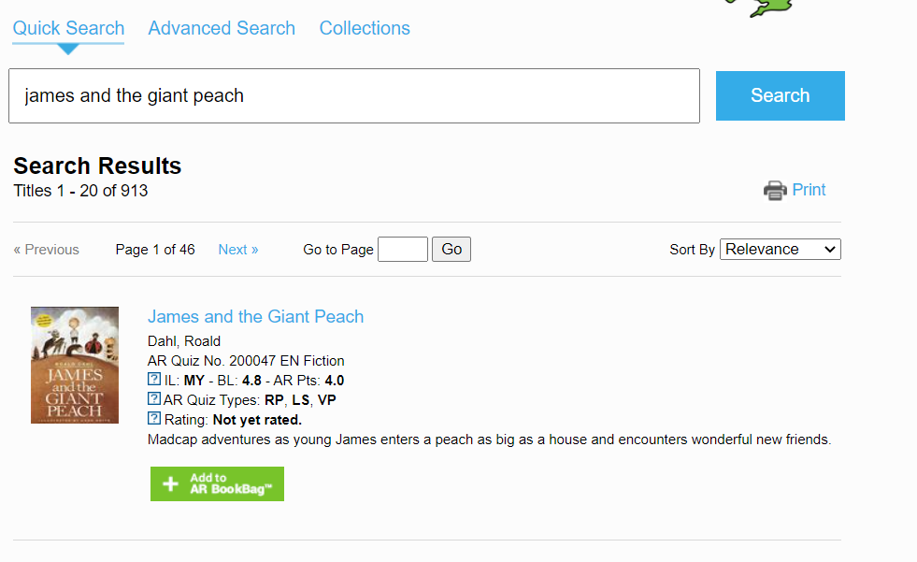
Are other books on Accelerated Reader?
YES!
Lots of books are on Accelerated Reader. You could try searching for some books you have read together at home!
www.arbookfind.com is a quick way to search and check.

Slide 24
What can I do to support my child?
Ensure they bring their reading book to school every day.
Talk to them about what they are reading.
Read together every day. Take it in turns and always discuss what they have read with them. Can they ask you questions about it?
See if any of their favourite books at home are on Accelerated Reader for them to do the quiz on.

Slide 25
Thank you and any questions
Thank you for your support and for your patience in getting the children set up and running with the programme.
We have seen a really positive impact on our Year 4 and 5 children who have become more motivated readers that try to read a variety of different things. We hope the Year 3s are excited to begin their Accelerated Reader journey too ☺

