Slide 1
Year 6
Draper – Miss Frain, Mr Bond and Ms Rochfort

Slide 2
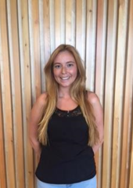
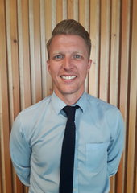
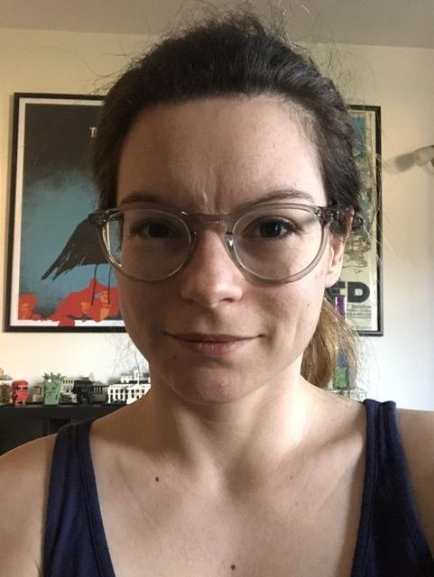
Us and Our Class

Slide 3
General
PE – Monday
Homework – Spellings set on Monday and tested on Monday. MyMaths will be set on a Friday and due the following Friday
Accelerated reader and Timestable Rockstars is on going and should be accessed at home
http://www.civitasacademy.co.uk/class-pages
Excellent attendance will offer your child the best possible chance for success
Clubs and trips will happen again – information will be sent out
Separate residential meeting to follow
Admin – Speak to Mrs Phillips in Reception re: change of personal details, photo consent, Tucasi, bulletin etc
Check communication policy
Email year6@civitasacademy.co.uk

Slide 4
Reading
Children should use accelerated reader
Read a broad range of fiction and non-fiction
Reading comprehension (SATs)

Slide 5
Writing
Children will be given opportunities to write extended pieces at school
Wide range of genres
Implementing SPAG
On-going assessment (Not a test)
TAF

Slide 6
Maths
Calculation policy on the website
Arithmetic
Reasoning and problem solving
Timestables Rockstars
Mymaths

Slide 7
SATs
W/C May 16th
Reading Comprehension
2 x Maths reasoning
1 x Artithmetic
SPAG
Booster sessions
Further SATs meeting in Aut 2
How you can help…
Attendance
Reading
Times tables
Homework

Slide 8
Global Themes
Sustainable Development

Slide 9
Any questions?
Thank you for attending! Hopefully you will be able to come into class at the end of term for the Project Celebration!

