Slide 1
Coronavirus Full Reopening Our New Routines

Slide 2
The Process
A risk assessment was completed to determine feasibility & control measures. The measures in the risk assessment are explained in this presentation.
This risk assessment has been revised accordingly in line with the latest Government advice.
Government guidance has been read and implemented.
This was completed by the leadership team supported by the staff and Chair of Governors.
Risk assessments and capacity analysis were reviewed by the REAch2 Executives & Trustees. The Executive & Trustees decided whether each school in REAch2 Multi Academy Trust was safe to open and to what extent.

Slide 3
The Decision
The school will reopen to all pupils on Monday March 8th 2021.

Slide 4
General Protocols
We are welcoming all pupils back full time
The school will be set up to support social distancing as much as possible
Pupils are in groups of 40-60 called a ‘year group bubble’
Each bubble has an allocated room, resources and toilet
Groups remain separate throughout the school day
Groups may pass each other in a corridor, maintaining distance, but not spend time together.
Pupils must wear school uniform to school unless it is a PE day

Slide 5
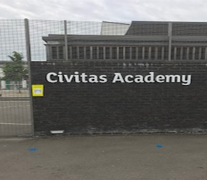
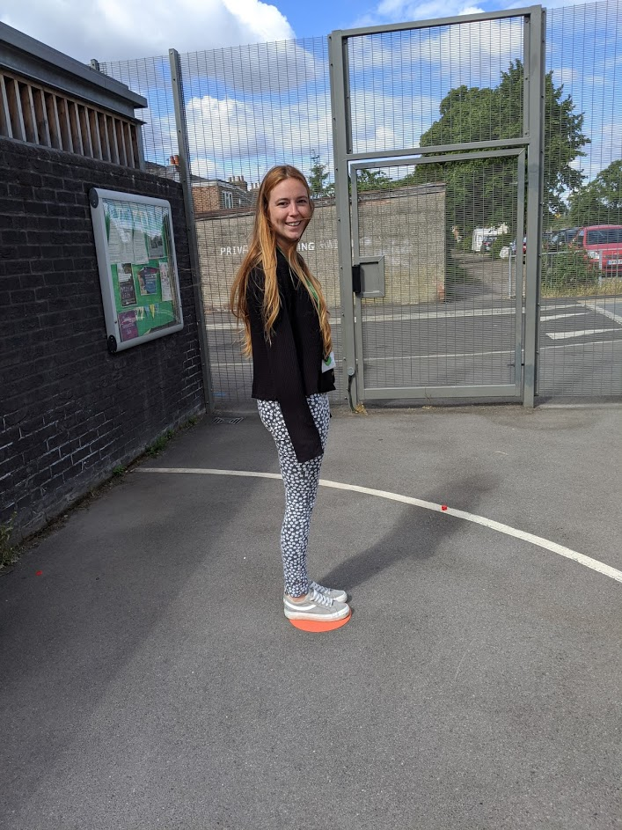
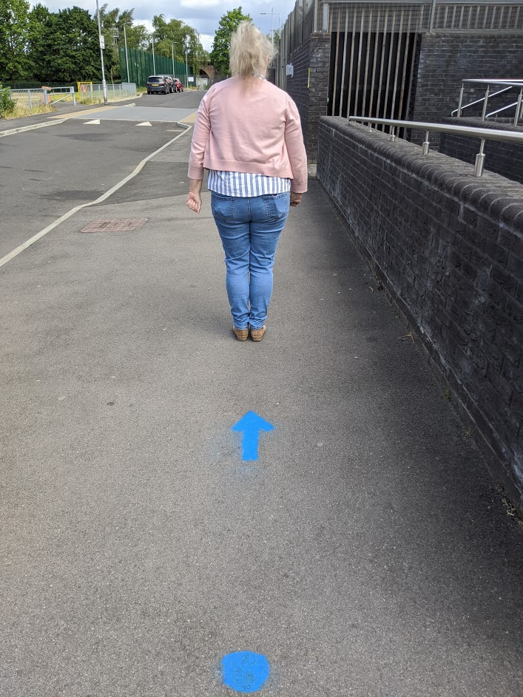
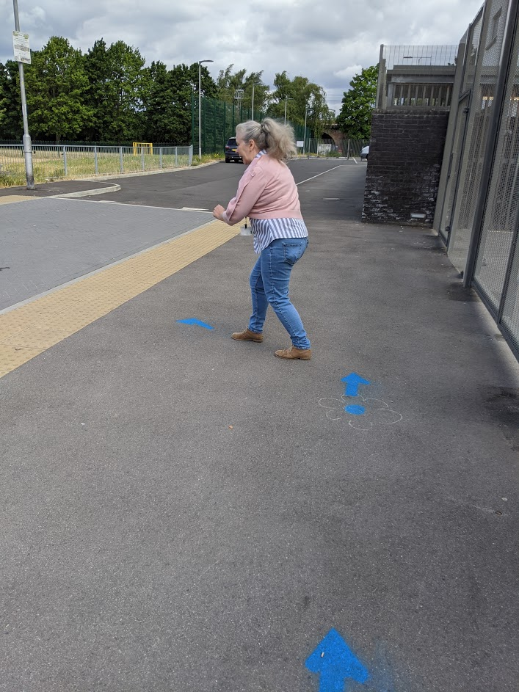
Drop off This is our busiest time of day and it is important that we maintain social distancing !
Every year group bubble has a time slot for drop off.
Entry via the gate
Only one adult to accompany children to school
Each family should wait on a dot on Hodsoll Road only moving forward when the family in front does so
One parent/carer only dropping off.
No parents to enter school building.
Please follow the one-way system indicated by arrows and as outlined by cones.
Please keep moving within the one way system once on the playground, to avoid congestion.
Pupils will walk to their bubble where they will be greeted by their teacher. They will enter the classroom immediately – they do not need to line up outside.
Years 2, 3 and 4 will use the outside stairs to walk up to the top deck and enter their classroom through the external doors. Year 5 will enter the school from the double doors on the playground nearest the office and walk through the school to their classroom. An adult will supervise.
Maintain social distancing. There are to be no gatherings.
Pupils wash hands on entry.
No waiting around outside the gates or on site.
Smile, laugh and be generous and kind.

Slide 6
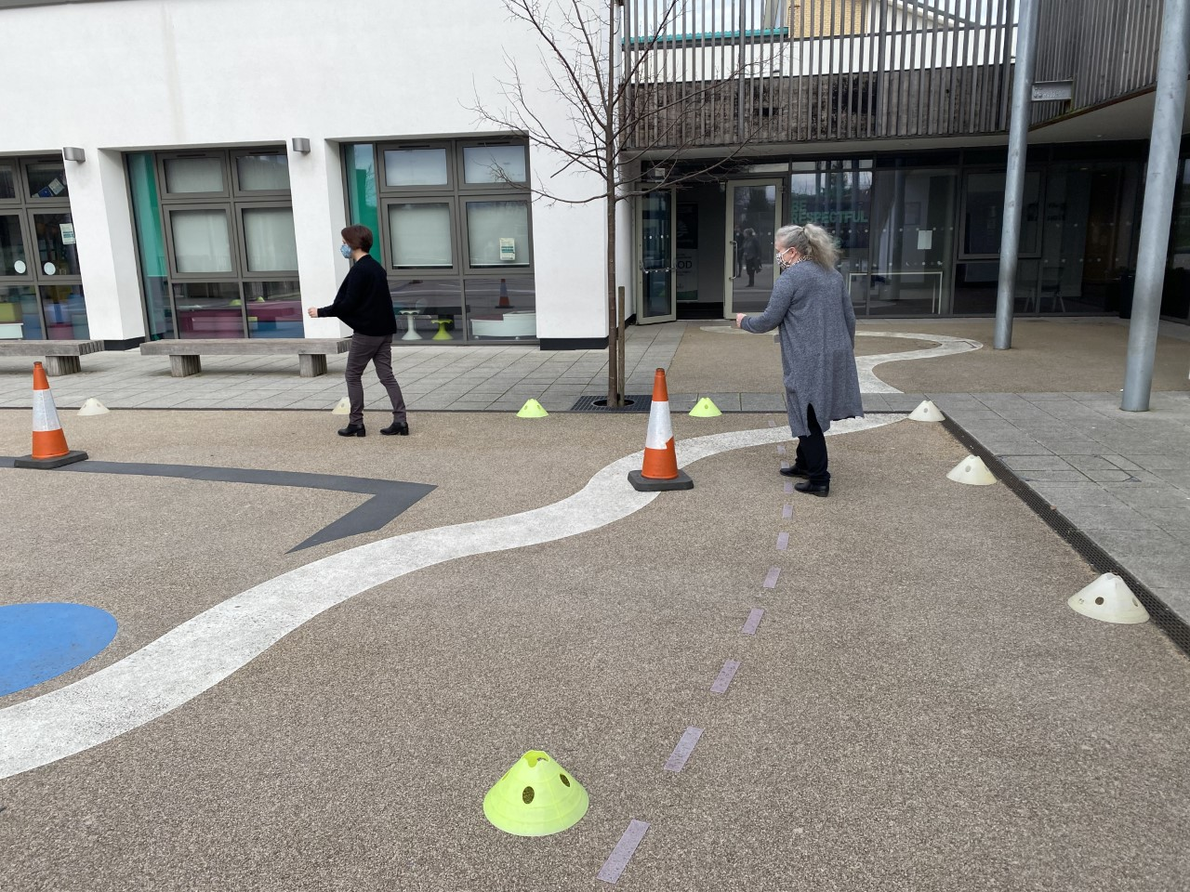
Pick up This is our busiest time of day and it is important that we maintain social distancing !
Every year group bubble has a time slot for pick up
Exit via the gate
Only one adult to collect children from school
Each family should wait on a dot on Hodsoll Road only moving forward when the family in front does so
One parent/carer only picking up.
Please follow the one-way system indicated by arrows and keep moving to avoid congestion.
Be mindful of 2 metre social distancing by not overtaking or 'cutting' across the playground.
Maintain social distancing. There are to be no gatherings.
Please ensure you are wearing your face covering correctly covering your nose and mouth (unless you are exempt).
No waiting around outside the gates or on site.
Children will wait in their allocated area in the playground to be dismissed by the adult working with that group at the end of the day.
Parents of siblings/childminders are encouraged to arrive at the cross over point of timings. If you are late for your collection time, respectfully join the end of the queue.
School procedures for collection will still apply; please inform the office if another adult is collecting your child.
Smile, laugh and be generous and kind.

Slide 7
Drop Off and Pick up Timetable
Class | Drop off | Location | Pick up | Location
Year R | 8:55-9:10am | Hodsoll Rd | 3:15- 3.20pm | Hodsoll Rd
Year 1 | 8:55-9:10am | Hodsoll Rd | 3:15- 3.20pm | Hodsoll Rd
Year 2 | 8:55-9:10 am | Hodsoll Rd | 3:15- 3.20pm | Hodsoll Rd
Year 3 | 8:40-8:55 am | Hodsoll Rd | 3:00- 3:10pm | Hodsoll Rd
Year 4 | 8:40-8:55 am | Hodsoll Rd | 3:00-3:10pm | Hodsoll Rd
Year 5 | 8:40-8:55 am | Hodsoll Rd | 3:00-3:10pm | Hodsoll Rd
Sensory room | Bespoke arrangements | As agreed by SENCo | Bespoke arrangements | As agreed by SENCo
Collecting Siblings: If collecting siblings from different year groups, please arrive at the crossover time. If you need to wait, please wait in the holding area which is in front of the gated staff car park. Please maintain social distancing.

Slide 8
Attendance
Attendance will be mandatory from Monday 8th March 2021 and normal policy expectations in operation.
We have put in measures to keep children safe and are looking forward to welcoming all pupils back.

Slide 9
Curriculum
We will continue with our ambitious and broad curriculum in all subjects but make use of existing flexibilities to create time to cover the most important missed content.
Our priority will be the core learning and children's wellbeing.
We will consider the educational needs of all pupils.
We will continue to develop remote education so that it is integrated into school curriculum planning should bubbles need to close.
Leaders will prioritise identifying gaps and re-establish good progress in the essentials (phonics and reading, increasing vocabulary, writing and mathematics).
Our curriculum will remain broad, so that most pupils are taught a full range of subjects over the year.

Slide 10
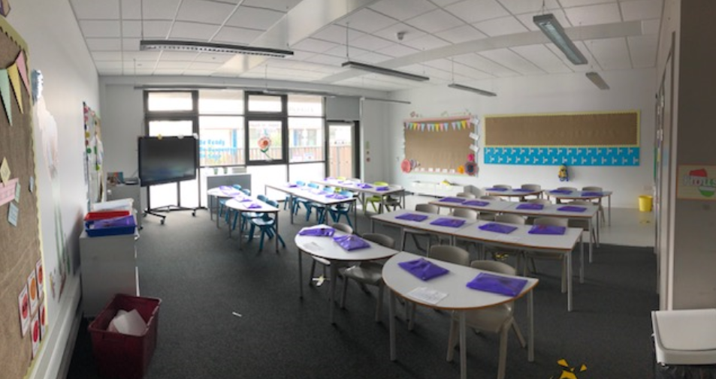
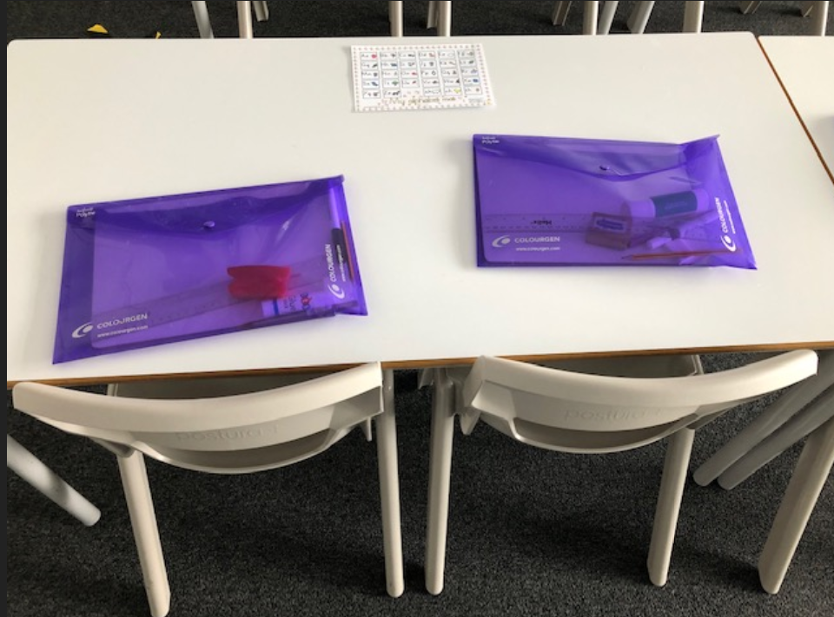
The Classrooms
Classrooms will be set up in rows with gaps between each table. There will be two children sat at each table.
All desks/seats will be facing forwards to minimise contact with others and support social distancing where possible
All unused furniture has been removed to create as much space as possible.
Pupils have their own allocated stationery in Year 1-6 which is stored in individual named packs and their own books and resources stored in a tray underneath the table.
Children will put their coats on their pegs. They should avoid bringing large bags to school wherever possible. Lunch boxes will be stored in the classrooms.
A named water bottle should be bought in daily.

Slide 11
EYFS and Year 1
Children will have resources that can be shared across their year group bubble.
The children will be encouraged to wash these shared resources in soapy buckets after they have finished using them.
Toys will be cleaned regularly with Milton
Children in Early Years and Year One will not be expected to sit at a desk all day
Year one children will have a tray/area where they can keep their own resources.

Slide 12
Sensory Room
Children will have resources that can be shared in their bubble
Toys will be cleaned regularly with Milton
Children in the Sensory room will not be expected to sit at a desk all day
They will have a tray/area where they can keep their own resources
The sensory room is ventilated and outdoor opportunities are offered.

Slide 13
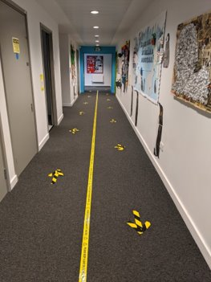
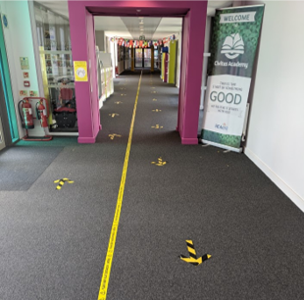
The School Building
Movement around the building is reduced.
Information posters are displayed around the school
One-way systems are in place.
Corridors will be clearly demarcated to indicate sides and direction.
Everyone walks on the left and passing in corridors is limited.
Windows are open for ventilation.

Slide 14
PE Timetable
Year Group | PE Day
Reception | Wednesday
Year 1 | Tuesday
Year 2 | Thursday
Year 3 | Wednesday
Year 4 | Friday
Year 5 | Monday
Children should come into school wearing PE kit on their PE day
This is to decrease the risk of transmission from clothing
Long jogging bottoms can be worn as well as our school jumper.

Slide 15
The Playground
Each bubble will have a dedicated time on the playground.

Slide 16
Breaks and Lunch
Breaks and lunches are staggered for all groups.
Each bubble will stay on the allocated playground and use specific equipment.
Pupils must bring their own named water bottle
Pupils will play within their bubbles.
All children will eat in the hall with their own bubbles.
School dinners must be pre-ordered on Tucasi
No contact games on the playground.

Slide 17
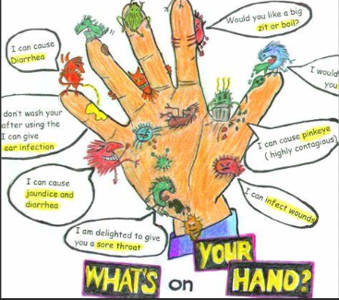
Hygiene and Cleaning
Everyone sanitises hands on entry to the building.
Pupils wash hands thoroughly on entry to the classroom.
Hands are washed at specific times throughout the day.
Bins for tissues and wipes are provided throughout the school
Good respiratory hygiene – use of tissues
Each group has an allocated toilet or cubicle.
A staff member is tasked with cleaning toilets, handles, doors and surfaces throughout the day.
The school is cleaned and disinfected at the end of each day.
Cleaning and kitchen staff wear appropriate PPE.

Slide 18
Evacuation
Pupils will evacuate the building in an orderly way, maintaining social distancing where it is safe to do so.
If there is an imminent risk, social distancing will not be maintained.
Pupils will line up in their groups at the evacuation point, maintaining social distancing from each other and other groups.
Groups will have the opportunity to practise this.

Slide 19
First Aid
If your child requires first aid staff will continue to implement our standard first aid procedures.
Staff will wear appropriate PPE where required. However, if there is an imminent risk staff will prioritise the application of first aid.
Staff will note down PPE used on the first aid form.
Where necessary staff will not be able to socially distance themselves to apply first aid.
All qualified first aiders are highlighted on posters throughout the school.

Slide 20
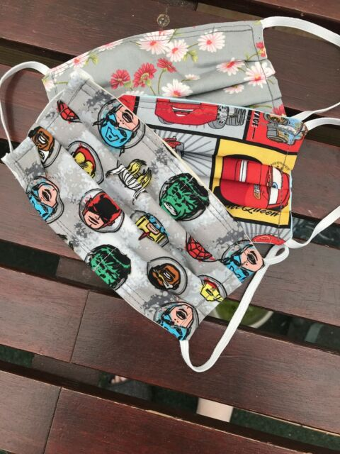
Face Coverings
"Public Health England does not (based on current evidence) recommend the use of face coverings for pupils in primary schools. This evidence will be kept under review.
Notes:
Public Health England does not (based on current evidence) recommend the use of face coverings in schools. This evidence will be kept under review. They are not required in schools as pupils and staff are mixing in consistent groups, and because misuse may inadvertently increase the risk of transmission. There may also be negative effects on communication and thus education.

Slide 21
Suspected Covid- 19 Cases
The individual will be isolated immediately in an allocated room.
Staff will wear full PPE.
The pupil will be sent home and directed to book a test immediately.
They will be required to isolate for 10 days or until the test results are returned. The family, including any siblings, will be required to isolate for 10 days (unless a negative test is received).
Parents of children in the year group bubble will be informed of a positive test result. All members of the year group bubble will be required to isolate for 10 days. Remote learning opportunities will be provided.
Any household isolating must inform the school.

Slide 22
Engaging with Test and Trace
Everyone in school who displays symptoms must book at test by following this link: https://www.gov.uk/guidance/contacts-phe-egions-and-local-centres
If your test is positive you must provide details of anyone you have been in close contact with through the test and trace service.
Self-isolate if they have been in close contact with someone who develops Coronavirus symptoms or where there is a positive test.
Parents/carers should inform schools the results of all tests.

Slide 23
Managing Confirmed Covid-19 Cases
We will take swift action in the case of a positive case of Coronavirus and contact the local health protection team. https://www.gov.uk/guidance/contacts-phe-regions-and-local-centres This team will also contact schools directly should they become aware of a positive case linked to the school.
Log any positive Coronavirus cases on Parago and immediately inform your DDoE.
Work with the local health protection team
Leaders will maintain a record of pupils and staff in each group and any close contact that takes place between children and staff in different groups.
Household members of those contacts sent home do not need to self-isolate themselves unless the child/adult who is self-isolating subsequently develops symptoms.

Slide 24
Containing an Outbreak
If our setting has 2 or more confirmed cases within 14 days or an overall rise in sickness absence where Coronavirus is suspected, we may have an outbreak.
We must continue to work with their local health protection team who will be able to advise if additional action is required.

Slide 25
Staff Testing
Staff who have chosen to do so are tested twice a week using the Lateral Flow Tests

Slide 26
Shielded Pupils
The advice for pupils who have been confirmed as clinically extremely vulnerable (CEV) is to shield and stay at home until further notice. They are advised not to attend school while shielding advice applies nationally.
A copy of the shielding letter sent to CEV children to confirm that they are advised not to attend school will be requested by the school.

Slide 27
Behaviour
This is a very challenging time for everyone, especially the children in our care. We have therefore adapted our behaviour policy to support pupils.
Ready | Respectful | Safe
Arrive within our time slot and go directly to our entrance door. Wear our school uniform or P.E. kit where possible (wash clothes regularly). Bring a named water bottle to school every day. | Respect the distance and space between others, including staff. Talk politely and respectfully to all. | Stay within our allocated space in the classroom. Stay within our outdoor area/zone. When arriving and leaving, walk on the pathways following social distancing guidelines.
Our Recognition
Staff will verbally recognise pupils following the new rules and guidance. For pupils who go ‘above and beyond’, staff will send an email of recognition to parents/carers so that this can also be celebrated at home.

Slide 28
Issue | Progressive Steps | Follow up
Accidentally breaching social distancing outside of bubble. | Step 1: Redirection and reminder | Catch up on work missed
Deliberately breaching social distancing outside of bubble. | Step 2: Caution | Catch up on work missed during free time
Deliberately breaching social distancing outside of bubble. more than once in a session. Commenting that someone has ‘coronavirus’ | Step 3: Time out within the bubble (indoor or outdoor), with choice to opt back in. | Reflect and repair during free time Catch up on missed work during free time
Repeatedly deliberately breaching social distancing outside of bubble. (despite instruction otherwise) or repeatedly being unkind to someone | Step 4: Time out with SLT Step 4 would be repeated inappropriate learner attitude and a lack of willingness to choose to take opportunities offered to opt back in at previous steps. | Reflect and repair during free time Catch up on missed work during free time Parents/carers informed by telephone
Breaching social distancing outside of bubble with intent to threaten or intimidate other pupils (eg, ‘pushing a child and saying ‘you’ve got coronavirus’). | Immediate escalation to Step 4 Time out or internal exclusion with SLT | Reflect and repair during free time Catch up on missed work during free time Parents/carers informed by telephone Internal or fixed term exclusion may be considered by the Executive Headteacher
Breaching social distancing outside of bubble and physically harming another pupil or repeatedly verbally abusing another pupil | Immediate escalation to Step 5 Internal with SLT or external exclusion. | Parents/carers informed by telephone Consideration if the exclusion will be: Internal - supervised by SLT Fixed term exclusion - at home

Slide 29
What Parents/Carers Must do
Continue to be patient, understanding, supportive and considerate.
Inform the office if your child is absent
Inform the office if you or any members of your household are isolating.
Remain socially distant, but still your usual good humoured and happy selves!
Stick to time slots for drop off and pick up.
Follow the government guidance: socially distance at all times, including weekends.

Slide 30
What Pupils Must do
Follow the new rules and guidance.
Continue to try their best.
Talk kindly and play with each other.
Smile and enjoy being together again!

Slide 31
Support and Wellbeing We recognise the need to focus on pupils’ emotional wellbeing as well as their return to learning.
We will spend a significant amount of time on supporting children through PSHE and wellbeing activities – leading and learning to thrive.
We will be kind and supportive to one another
We will put health and safety first
We will offer support to families that reach out to us

