Slide 1
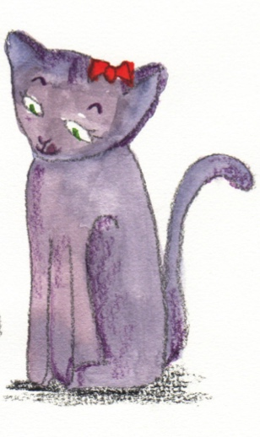
Adverbs

Slide 2
Adverbs
Verbs are doing, being or feeling words.
run
fly
think
speak
An adverb tells you more about a verb.
quickly
steadily
carefully
loudly
fly steadily
think quickly
speak carefully
Try modifying one of the verbs with one of the adverbs?
Revision

Slide 3
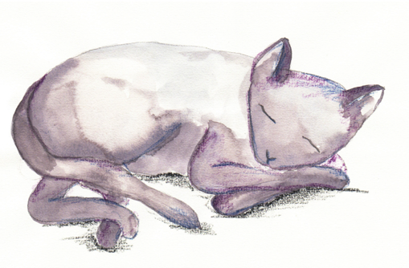
Adverbs
Some adverbs do not end in ly.
tomorrow
then
now
soon
here
there
They can still tell you more about a verb.
Where?
I lost my broomstick
here.
When?
I want a cat
now.
Try modifying one of the verbs with one of the adverbs

Slide 4
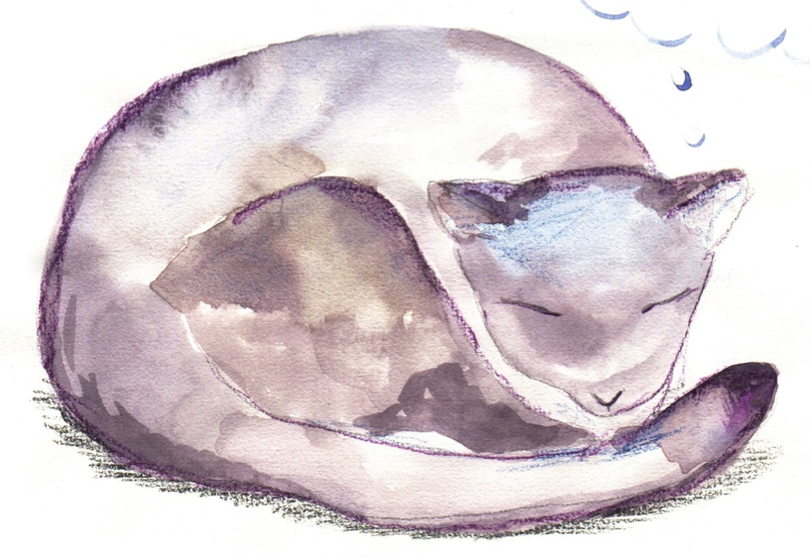
Adverbs
Adverbs tell us about when, where and why or how.
When?
The cat slept
daily.
The cat slept
earlier.
The cat slept
yesterday.
The verb ‘slept’ is modified by the adverbs.
Can you think of any other adverbs which answer the question: When?

Slide 5
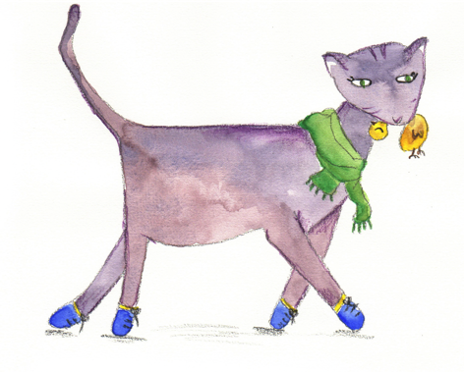
Adverbs
Adverbs tell us about when, where and why or how.
Where?
The cat walked
here.
The cat walked
there.
The cat walked
outside.
The verb ‘walked’ is modified by the adverbs.
Can you think of any other adverbs which answer the question: Where?

Slide 6
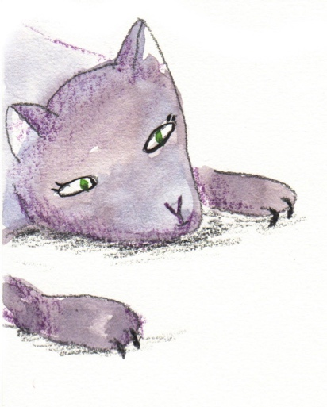
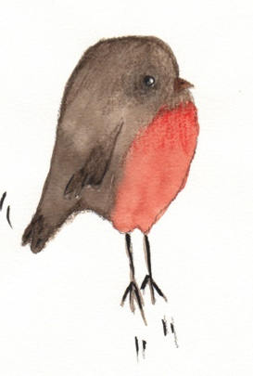
Adverbs
Adverbs tell us about when, where and how or why.
The cat watched
silently.
How?
The cat watched
intently.
The cat watched
avidly.
The verb ‘watched’ is modified by the adverbs.
Can you think of any other adverbs which answer the question: Why?

